Slide 1
Getting started with scrapy
Scraping olx.com for bikes and cars

Slide 2
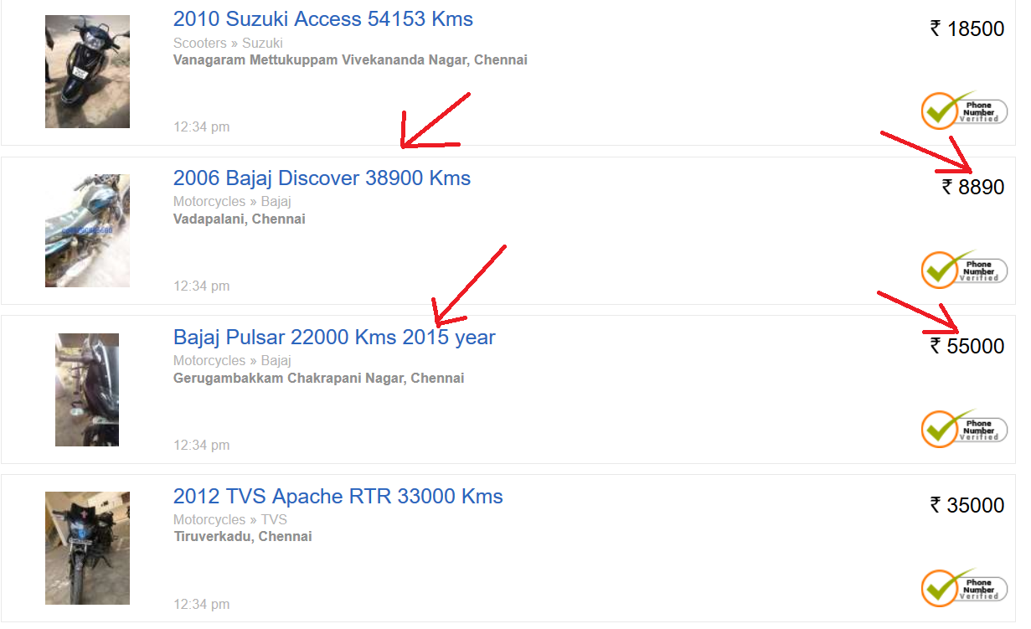
Web-scraping
Extracting information from web pages and following links between pages

Slide 3
Scrapy
Python framework for web scraping (and web api extraction)
Built on top of the Twisted asynchronous networking library
Extensible

Slide 4
Code: Scrapy spider
Class inheriting from scrapy.Spider
Must have a name attribute which should be unique in the project. This is used to identify the spider
start_urls specifies a list of urls to crawl additional links may be followed and crawled
parse(self, response) function with the logic to handle the response received should yield scrapy.Item or scrapy.Request or dict
Scrapy.Request objects are used follow links. It must specify url and callback function to parse the response

Slide 5
Code example 1: single file
Self contained file. Simple.
Suitable for one time extraction / small works

Slide 6
Code example 2: project structure
Used to group multiple spiders in the same project.
Allows for additional settings
Handling the results

Slide 7
Code example 3: Item and ItemLoader
scrapy.Item allows for creating schema crawled data.
Allows additional rules/sanity checks and preprocessing for ach field.
Separtion for extraction code and data processing code.
scrapy.loader.ItemLoader convenient mechanism for populating Items and parsing.
Allows custom pre-processor definitions for pre-processing

Slide 8
Questions
This was a very small introduction to scrapy.
https://github.com/shanmuga-cv/scrapy-getting-started
For detailed tutorial refer
https://doc.scrapy.org/en/latest/intro/tutorial.html
https://www.youtube.com/watch?v=vkA1cWN4DEc&list=PLZyvi_9gamL-EE3zQJbU5N3nzJcfNeFHU

Slide 9
About me
BigData, Python, Macine-Learning
Scraping???
https://github.com/shanmuga-cv/
https://twitter.com/sachi_vel
Shanmuga.chidambaravel@gmail.com

